Slide 1
Project of Artificial Intelligence in Finance
Trading Strategy for Quantopian Contest
LI, Fanyi 20670679
Du Yushu 20660193
HUANG, Jian 20665844
Tong Jiaqu 20660143
YU Rong 20195605

Slide 2
Strategy Overview
RSI Strategy
Control Leverage Strategy
Turtle Trading Strategy
Momentum Trading Strategy
Differential Trend Motion Strategy
Psy Strategy
Pairs trading

Slide 3
RSI Strategy
LI, Fanyi

Slide 4


Trading Strategy
1
RSI Introduction
2
Our strategy – RSI Trading Strategy
3
Performance

Slide 5
PART ONE: RSI introduction
RSI Strategy
Relative Strength Index(RSI) is a technical indicator basing on the theory of supply- demand balance to measure stock’s or market’s intrinsic strength or weakness.
The formula for RSI:

Slide 6
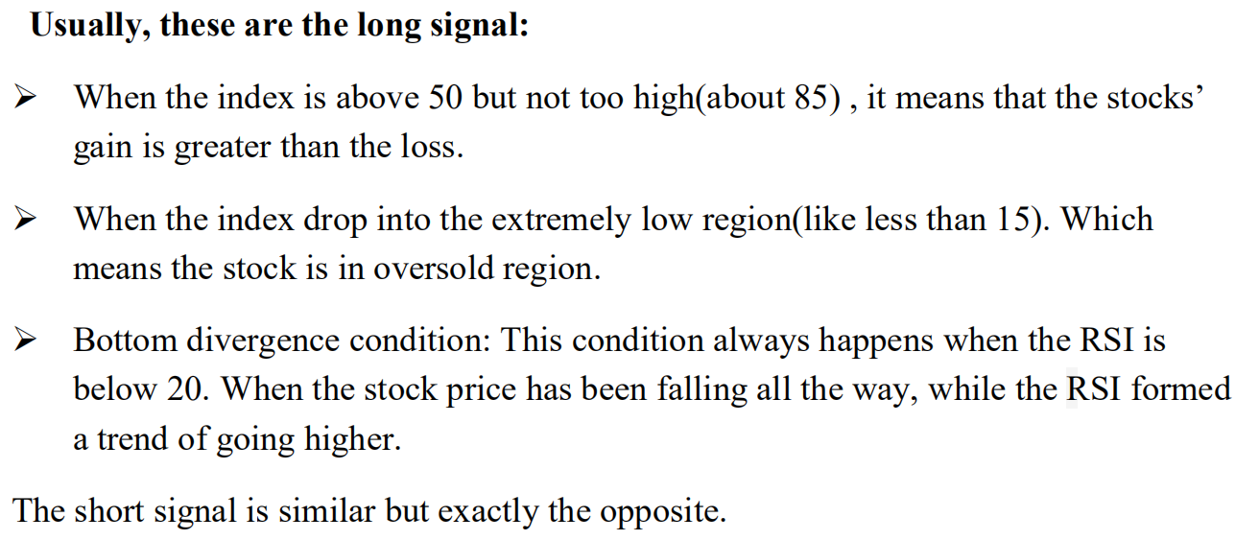
PART ONE: RSI introduction

Slide 7
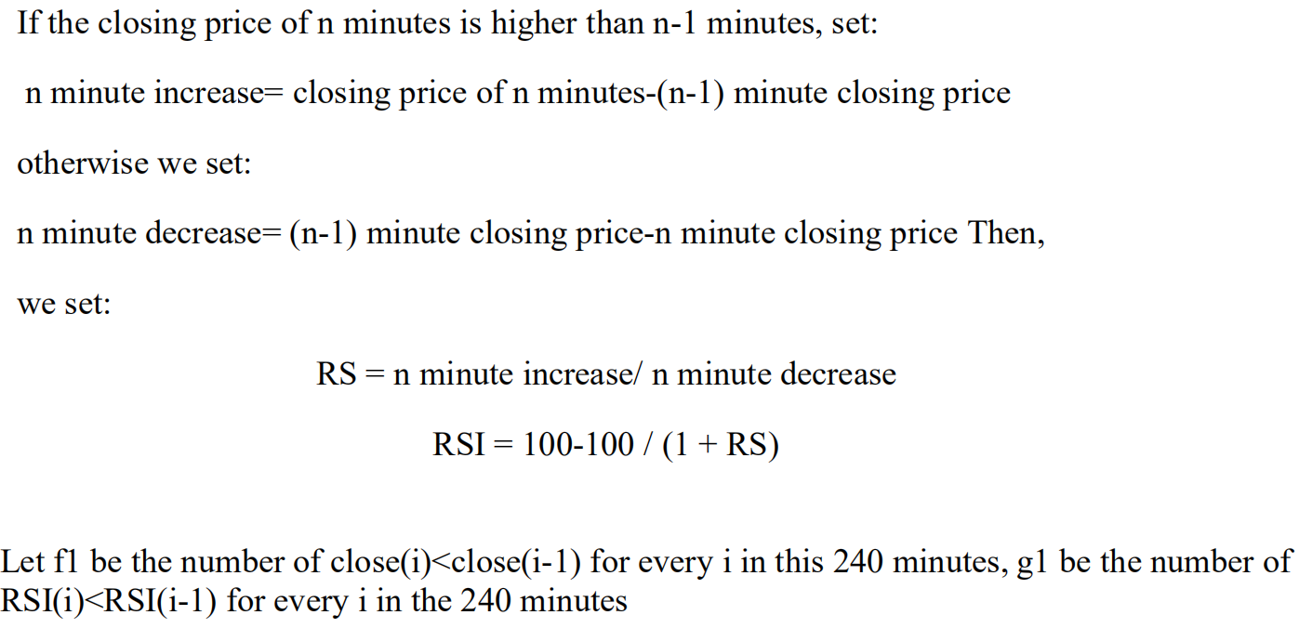
PART TWO: Our strategy – RSI Trading Strategy
Calculation of RSI indicator:

Slide 8
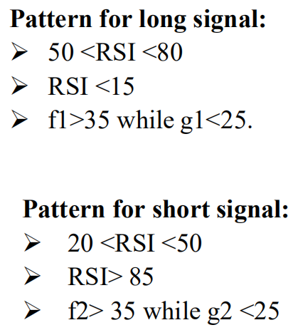
PART TWO: Our strategy – RSI Trading Strategy

Slide 9
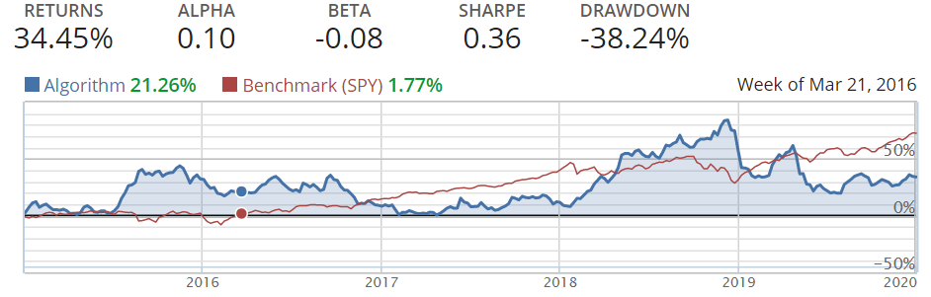
PART Three: Performance
Data used: stock ‘AAPL’

Slide 10
Control Leverage Strategy
LI, Fanyi&Tong Jiaqu

Slide 11
Trading Strategy
1
Strategy Introduction
2
Our strategy
3
Performance

Slide 12
PART ONE: Strategy Introduction
Control Leverage Strategy
The main idea of the strategy is doing momentum strategy while keep account leverage limited to 2.5x.

Slide 13
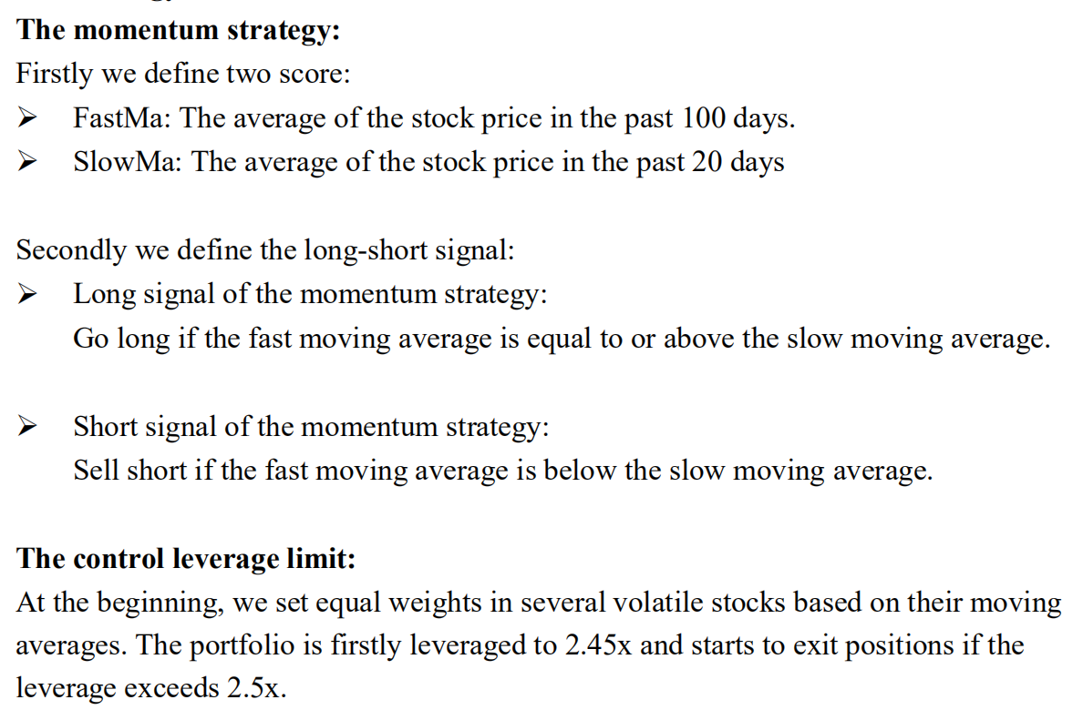
PART TWO: Our strategy

Slide 14
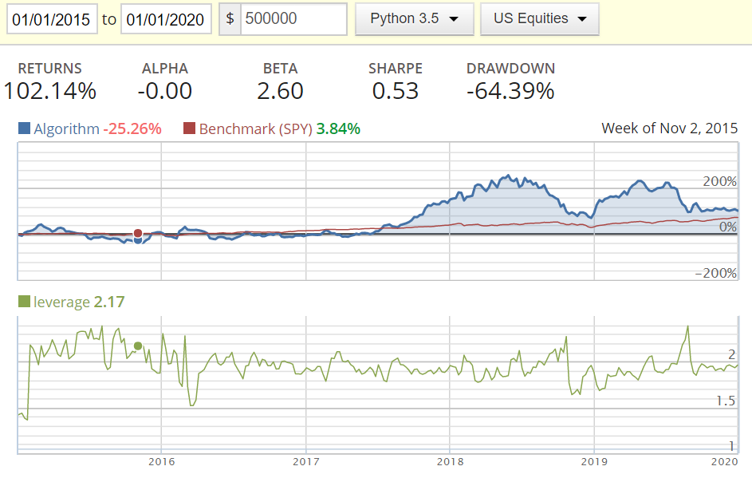
PART Three: Performance
Data used: ‘FSLR', 'CREE', 'GRPN', 'NFLX', 'GMCR'

Slide 15
Turtle Trading Strategy
Du Yushu

Slide 16
Turtle Trading Strategy
Turtle trading is a well known trend following strategy that was originally taught by Richard Dennis.
The basic strategy is to buy futures on a 20-day high (breakout) and sell on a 20-day low.
Basic method: when the price breaks the upper rail, it is a buy signal; conversely, when the price breaks the lower rail, it is a sell signal.

Slide 17
Turtle Trading Strategy
The calculation method of this indicator is: upper line = Max (highest price, n) lower line = Min (lowest price, n) midline = (upper line + lower line) / 2
Position: When opening a position for the first time, that is, when the price breaks through Donchian Chennel, buy 1 Unit. The significance is to make a fluctuation of N value correspond to the fluctuation of 1% of the total funds held. If you buy 1 Unit (unit) of assets, the amplitude of the day makes the change of total assets not exceed 1%.

Slide 18
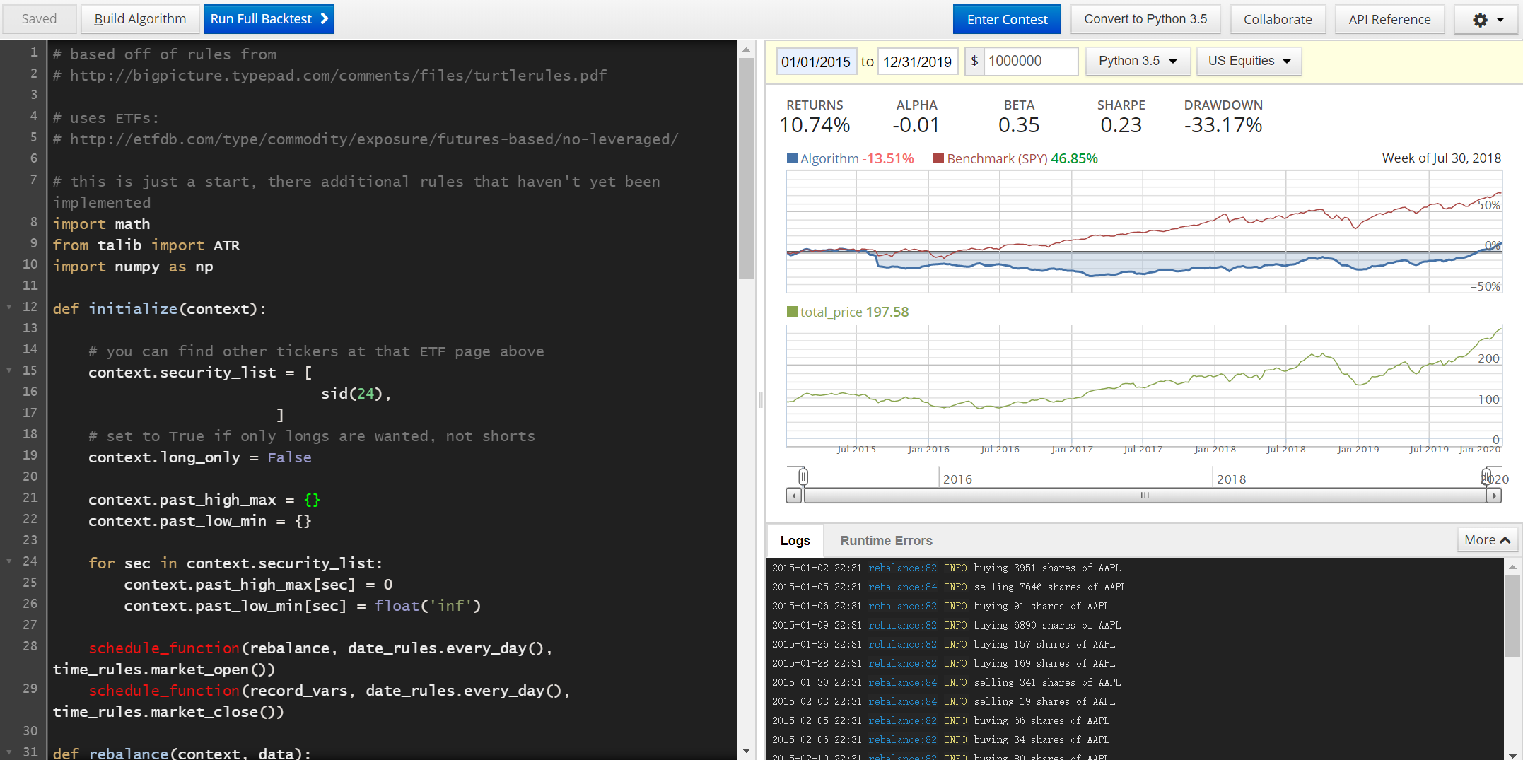
Results

Slide 19
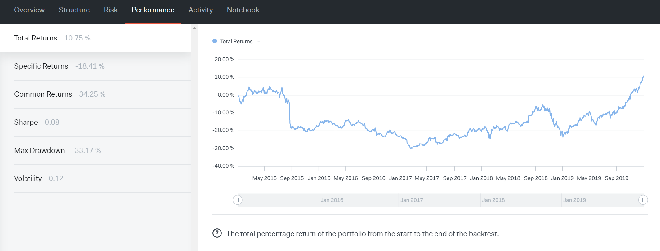
Results

Slide 20
Momentum Trading Strategy
Du Yushu

Slide 21
Momentum Trading Strategy
Momentum effect refers to assets with higher returns in the past, which will still obtain higher returns in the future, and assets with lower returns in the past will still receive lower returns in the future. Momentum effect was proposed by Jegadeesh and Titman (1993). They believe that the return of stocks has a tendency to continue the original direction of movement, that is, stocks with higher returns in the past period will still achieve higher than average returns in the future. Momentum effect is to study the past historical market and predict that the past market will continue.

Slide 22
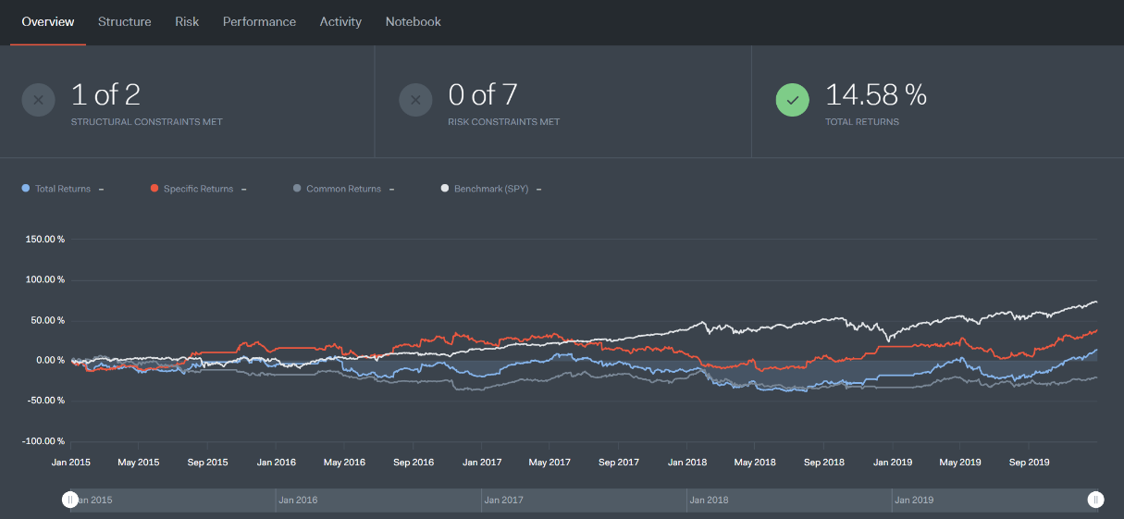
Results

Slide 23
Differential Trend Motion Strategy
HUANG, Jian

Slide 24
Data Selection and introduction
AINV (Apollo Investment Corporation)
ANF. (Abercrombie & Fitch Co.)
Two stocks
Back-testing system: at the Jupyter-notebook platform of Quantopian.
Testing set
20%
Training set
80%
Time line: Jan. 2nd, 2004 to May. 22th, 2020

Slide 25
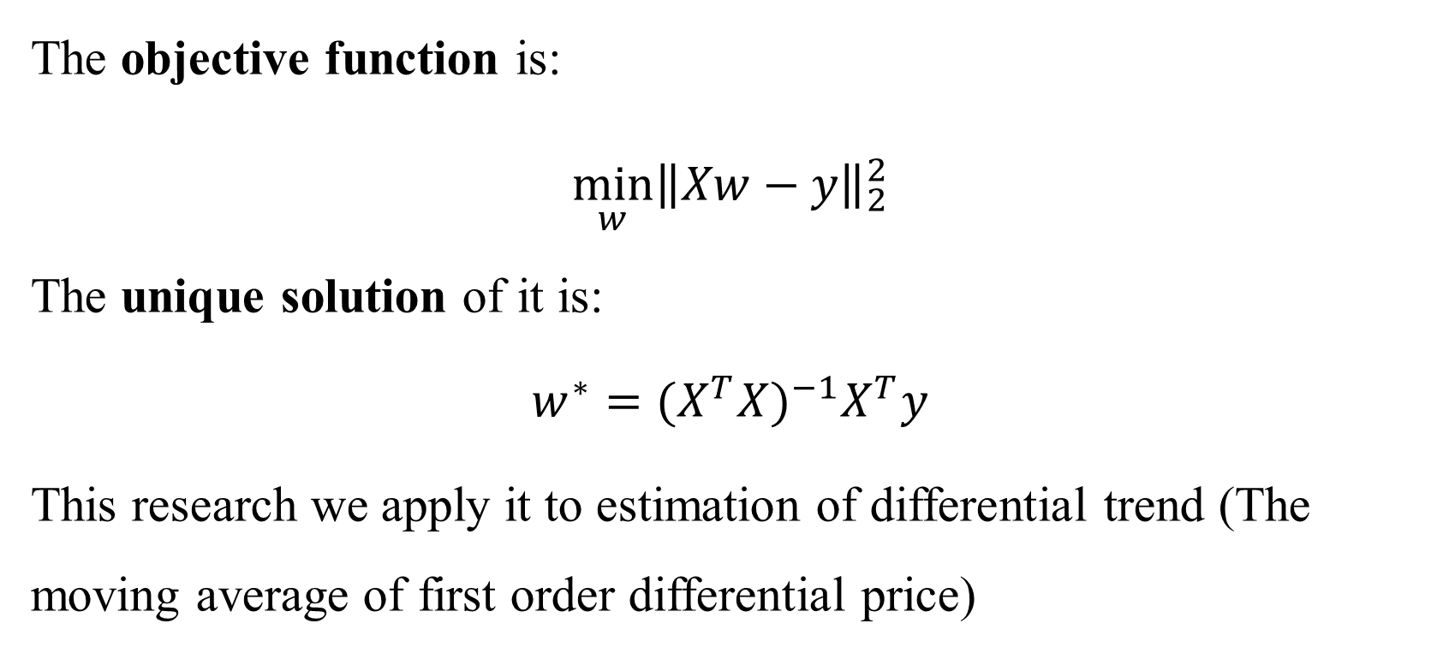
Least square regression
The objective function is:
$$\min_{w}{{\left\|Xw−y\right\|}_{2}^{2}}$$
The unique solution of it is:
$$w^{∗}={(X^{T}X)}^{−1}X^{T}y$$
This research we apply it to estimation of differential trend (The moving average of first order differential price)

Slide 26
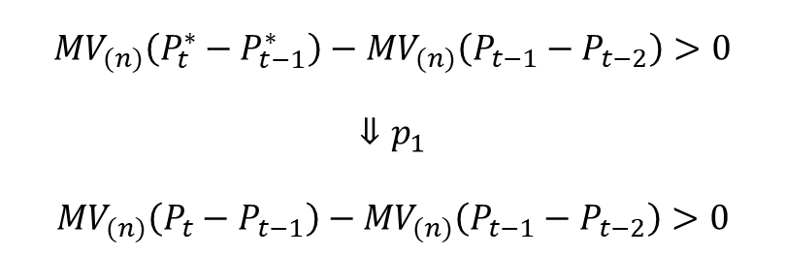
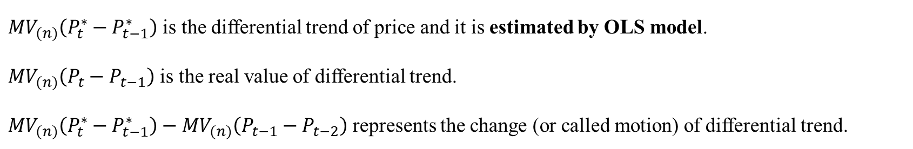
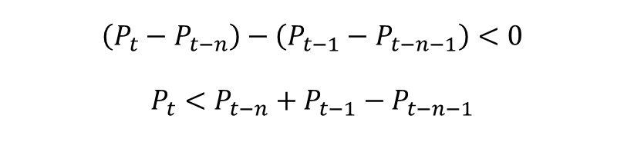
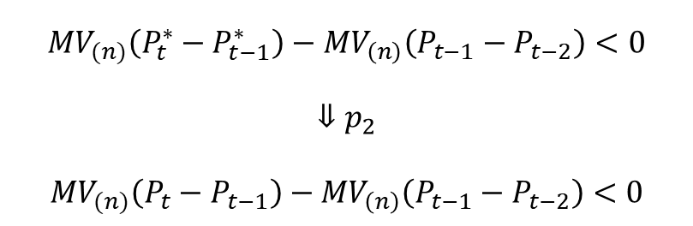
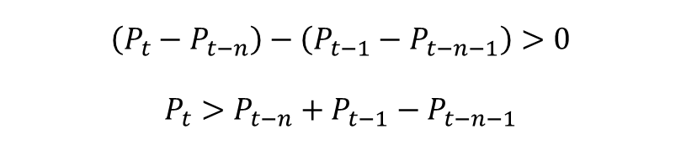
Differential trend motion model
${MV}_{(n)}\left(P_{t}^{∗}−P_{t−1}^{∗}\right)$ is the differential trend of price and it is estimated byOLS model.
${MV}_{(n)}\left(P_{t}−P_{t−1}\right)$ is the real value of differential trend.
${MV}_{(n)}\left(P_{t}^{∗}−P_{t−1}^{∗}\right)−{MV}_{(n)}\left(P_{t−1}−P_{t−2}\right)$ represents the change (or called motion) of differential trend.
$${MV}_{(n)}\left(P_{t}^{∗}−P_{t−1}^{∗}\right)−{MV}_{(n)}\left(P_{t−1}−P_{t−2}\right)>0$$
$$⇓p_{1}$$
$${MV}_{(n)}\left(P_{t}−P_{t−1}\right)−{MV}_{(n)}\left(P_{t−1}−P_{t−2}\right)>0$$
$${MV}_{(n)}\left(P_{t}^{∗}−P_{t−1}^{∗}\right)−{MV}_{\left(n\right)}\left(P_{t−1}−P_{t−2}\right)<0$$
$$⇓p_{2}$$
$${MV}_{(n)}\left(P_{t}−P_{t−1}\right)−{MV}_{\left(n\right)}\left(P_{t−1}−P_{t−2}\right)<0$$
$$\left(P_{t}−P_{t−n}\right)−\left(P_{t−1}−P_{t−n−1}\right)>0$$
$$P_{t}>P_{t−n}+P_{t−1}−P_{t−n−1}$$
$$\left(P_{t}−P_{t−n}\right)−\left(P_{t−1}−P_{t−n−1}\right)<0$$
$$P_{t}<P_{t−n}+P_{t−1}−P_{t−n−1}$$
Supported line
Restricted line

Slide 27
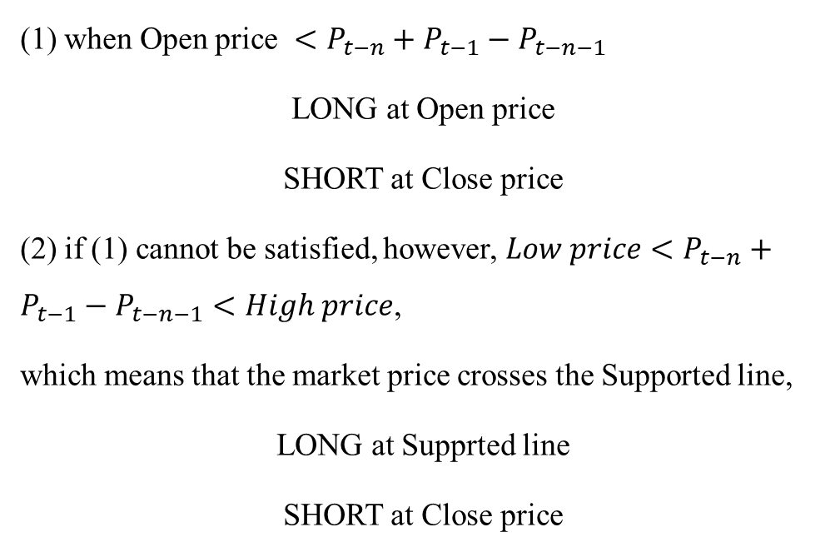
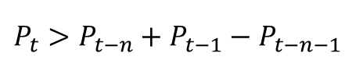
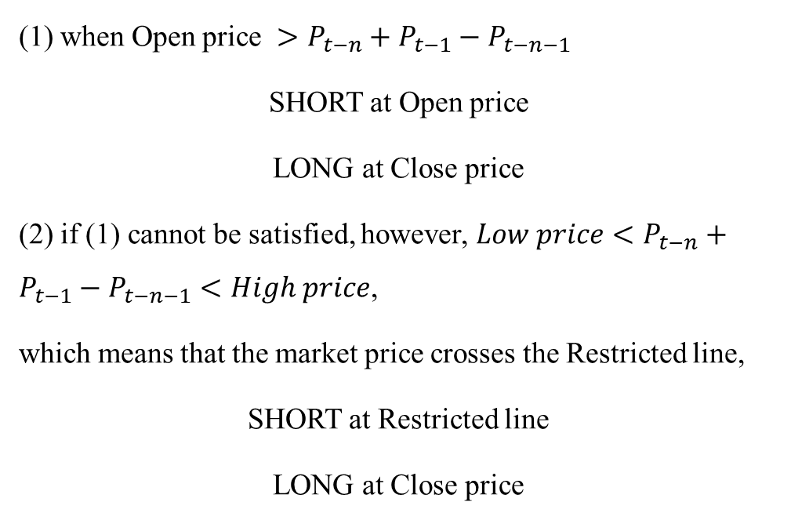
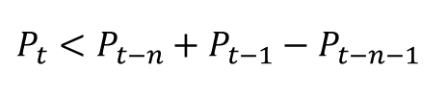
Factors that affect the trading strategies
Judgement of trading
$$P_{t}>P_{t−n}+P_{t−1}−P_{t−n−1}$$
$$P_{t}<P_{t−n}+P_{t−1}−P_{t−n−1}$$
(1) when Open price $<P_{t−n}+P_{t−1}−P_{t−n−1}$
LONG at Open price
SHORT at Close price
(2) if (1) cannot be satisfied, however, $Low price<P_{t−n}+P_{t−1}−P_{t−n−1}<High price$,
which means that the market price crosses the Supported line,
LONG at Supprted line
SHORT at Close price
(1) when Open price $>P_{t−n}+P_{t−1}−P_{t−n−1}$
SHORT at Open price
LONG at Close price
(2) if (1) cannot be satisfied, however, $Low price<P_{t−n}+P_{t−1}−P_{t−n−1}<High price$,
which means that the market price crosses the Restricted line,
SHORT at Restricted line
LONG at Close price

Slide 28
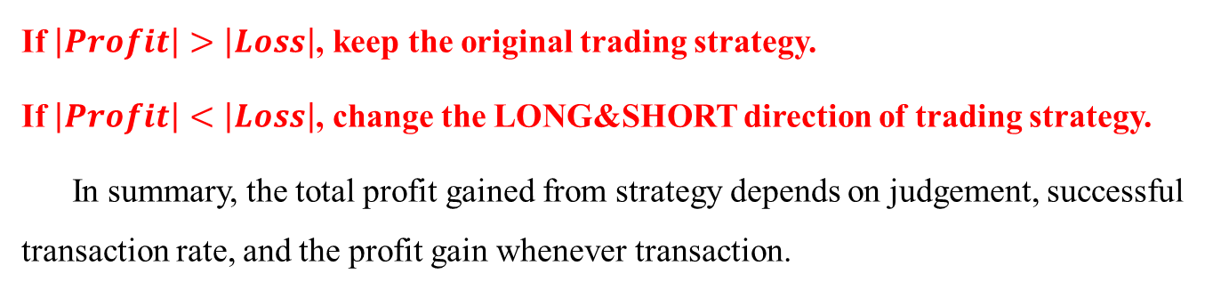
Factors that affect the trading strategies
 | Judgement
 | Right | Wrong
Have transaction | Profit | Loss
No transaction | No profit | No profit
If $\left|Profit\right|>\left|Loss\right|$, keep the original trading strategy.
If $\left|Profit\right|<\left|Loss\right|$, change the LONG&SHORT direction of trading strategy.
In summary, the total profit gained from strategy depends on judgement, successful transaction rate, and the profit gain whenever transaction.

Slide 29
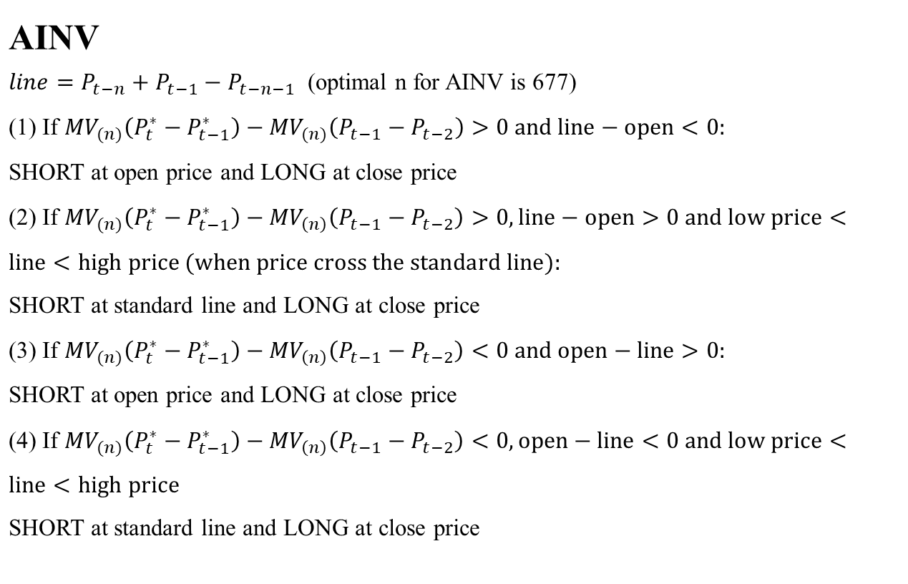
Differential trend motion Strategy for two stocks (AINV and ANF)
AINV
$line=P_{t−n}+P_{t−1}−P_{t−n−1}$ (optimal n for AINV is 677) (1) If ${MV}_{(n)}\left(P_{t}^{∗}−P_{t−1}^{∗}\right)−{MV}_{(n)}\left(P_{t−1}−P_{t−2}\right)>0 and line−open<0:$ SHORT at open price and LONG at close price (2) If ${MV}_{(n)}\left(P_{t}^{∗}−P_{t−1}^{∗}\right)−{MV}_{\left(n\right)}\left(P_{t−1}−P_{t−2}\right)>0, line−open>0 and low price<line<high price (when price cross the standard line):$ SHORT at standard line and LONG at close price (3) If ${MV}_{(n)}\left(P_{t}^{∗}−P_{t−1}^{∗}\right)−{MV}_{\left(n\right)}\left(P_{t−1}−P_{t−2}\right)<0 and open−line>0:$ SHORT at open price and LONG at close price (4) If ${MV}_{(n)}\left(P_{t}^{∗}−P_{t−1}^{∗}\right)−{MV}_{\left(n\right)}\left(P_{t−1}−P_{t−2}\right)<0, open−line<0 and low price<line<high price$ SHORT at standard line and LONG at close price

Slide 30
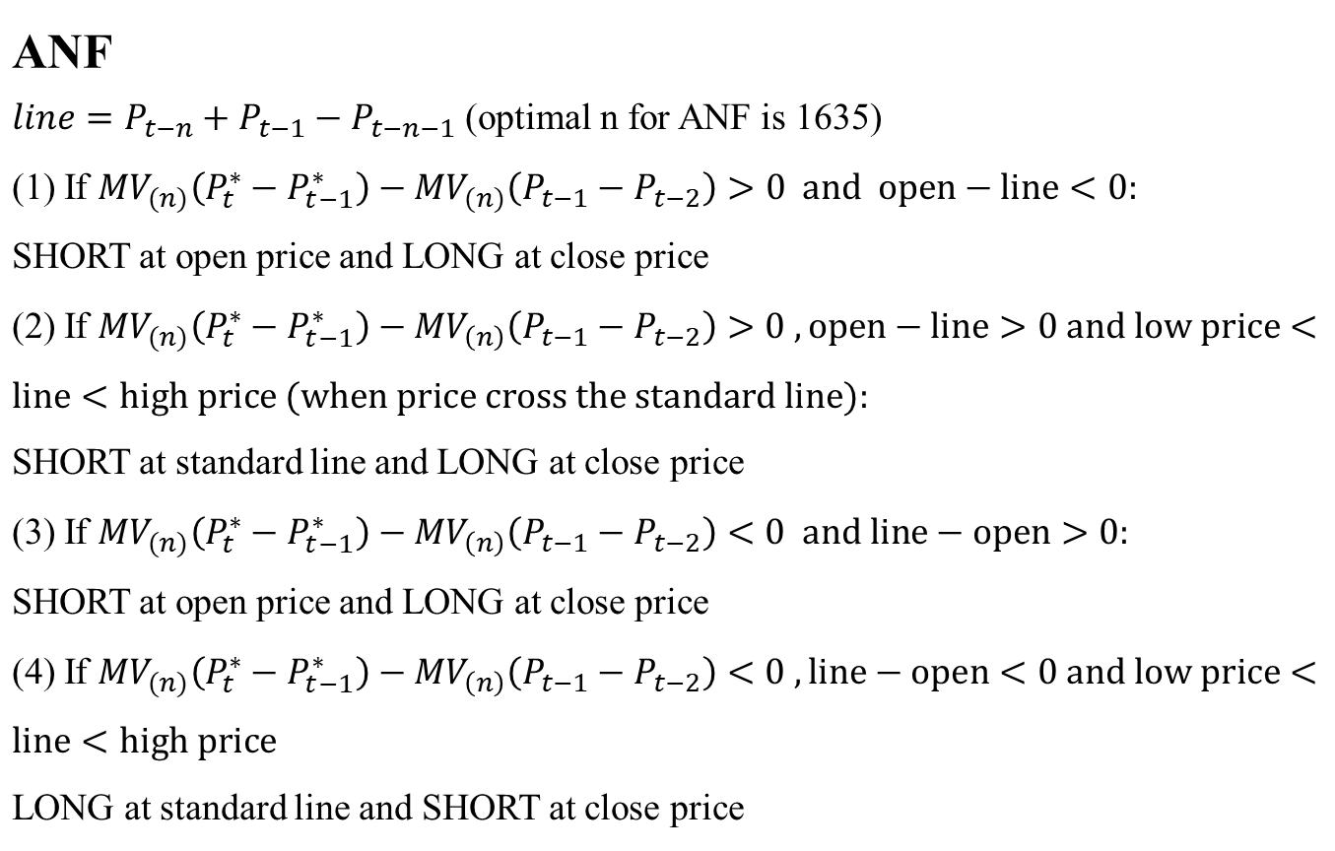
Differential trend motion Strategy for two stocks (AINV and ANF)
ANF
$line=P_{t−n}+P_{t−1}−P_{t−n−1}$ (optimal n for ANF is 1635) (1) If ${MV}_{(n)}\left(P_{t}^{∗}−P_{t−1}^{∗}\right)−{MV}_{(n)}\left(P_{t−1}−P_{t−2}\right)>0 and open−line<0:$ SHORT at open price and LONG at close price (2) If ${MV}_{(n)}\left(P_{t}^{∗}−P_{t−1}^{∗}\right)−{MV}_{\left(n\right)}\left(P_{t−1}−P_{t−2}\right)>0 ,open−line>0 and low price<line<high price (when price cross the standard line):$ SHORT at standard line and LONG at close price (3) If ${MV}_{(n)}\left(P_{t}^{∗}−P_{t−1}^{∗}\right)−{MV}_{\left(n\right)}\left(P_{t−1}−P_{t−2}\right)<0 and line−open>0:$ SHORT at open price and LONG at close price (4) If ${MV}_{(n)}\left(P_{t}^{∗}−P_{t−1}^{∗}\right)−{MV}_{\left(n\right)}\left(P_{t−1}−P_{t−2}\right)<0 , line−open<0 and low price<line<high price$ LONG at standard line and SHORT at close price

Slide 31
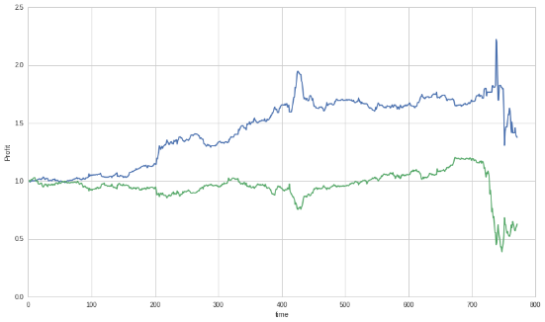
Result of back-testing
AINV
Optimal order | 677
Annual return of strategy | 0.12205754
Annual return of benchmark | -0.12091812
Sharp ratio of strategy | 0.18268332
Sharp ratio of benchmark | -0.59718986
Daily maximum drawdown | -0.31120463
Daily 5% VAR of strategy | -0.04851153
blue line is the strategy performance and green line is benchmark which is buying and holding strategy

Slide 32
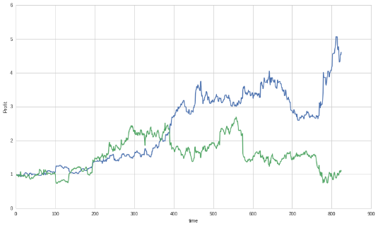
Result of back-testing
ANF
Optimal order | 1635
Annual return of strategy | 1.09299462
Annual return of benchmark | 0.03012813
Sharp ratio of strategy | 1.02593541
Sharp ratio of benchmark | -0.01028494
Daily maximum drawdown | -0.36371073
Daily 5% VAR of strategy | -0.11235758
blue line is the strategy performance and green line is benchmark which is buying and holding strategy

Slide 33

Psy Strategy
Tong Jiaqu

Slide 34
PART ONE Pipeline API
Pipeline API
select assets by the method of flitering
set a function to determine the value of assets
assign weights to each asset in the portfolio

Slide 35
PART TWO Psy Strategy
Psy Strategy
Use the simple moving average and bull_minus_bear index in the stockwits module to define a moving average curve.
The object gotten is named psy.
The strategy:
Assets with high psy values are considered high-value assets and vice versa.
Then, based on the psy value of the asset and accepting some restrictions, find a target portfolio with the highest profit.

Slide 36
PART TWO Psy Strategy
Psy Strategy
Rebalance: once a week
Three constraints:
The ratio of each asset to all assets held (size)
The ratio set in the strategy is 0.05, which means that the maximum share of an asset in all assets cannot exceed 5%.
Leverage ratio
In the strategy, the leverage ratio is set to 1, that is, short selling is not allowed.
Turnover rate
The turnover rate is set to 0.60, which means that all assets cannot be changed at the same time in one rebalance.

Slide 37
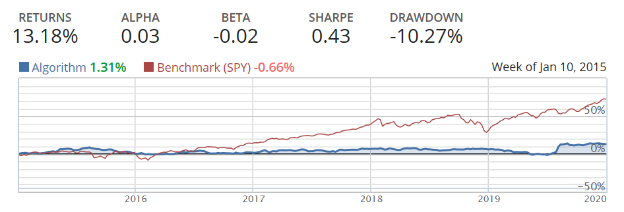
PART TWO Psy Strategy
Figure: Algorithm and benchmark performance from 2015-01-01 to 2019-12-31

Slide 38
Pairs Trading
Yu Rong

Slide 39
Trading Strategy
1
Pairs Trading Introduction
2
Our strategy – Multiple Pairs Trading
3
Stock Selection
4
Parameter Setting
5
Performance

Slide 40
PART ONE: Pairs trading introduction
Pairs Trading
attempts to resolve this using the idea of relative pricing; that is, if two stocks whose prices showed similar behavior over a long period of time, then the prices of both securities must be more or less the same
involves a long-short position when the spread is substantially away from its mean value, betting that the mispricing is likely to correct itself
The greater the spread, the higher the magnitude of mispricing and greater the profit potential

Slide 41
PART TWO: Multiple pairs trading (all possible pairs among 10 stocks)
Step 1
Step 2
Step 3
Define hedged spread :
Spread = Stock1Price – HedgeRatio x Stock2Price
Define Z-score:
Z-score = ( SMA30(Spread) - Spread ) / STD30(Spread)
short spread when its value rises above 2 standard deviations (Z-score > EnterThreshold); long the Spread when its value rises above 2 standard deviations (Z-score < -EnterThreshold).
Step 4
Step 5
Exist any spread position when its value is within 0.2 standard deviation of its mean (Exit the short position if Z-score < ExitThreshold; exit the long position if Z-score > -ExitThreshold)
Trade all possible pairs among selected securities.

Slide 42
PART THREE: Stock Selection
JD.COM (‘JD’), Alibaba (‘BABA’), Apple Inc. (AAPL), Microsoft Corporation (‘MSFT’), Concho Resources Inc. ('CXO'), Pioneer Natural Resources Compa ('PXD'), Analog Devices Inc. ('ADI'), Texas Instruments Incorporated ('TXN'), McDonald’s Corporation ('MCD'), Coca-Cola Company('KO').

Slide 43

PART FOUR: Parameter Setting
Hedge Ratio
EnterThreshold
ExitThrehold
the numbers of shares of the second security versus one share of the first security
perform a regression analysis to determine the hedge ratio
2 standard deviations
0.2 standard deviation

Slide 44
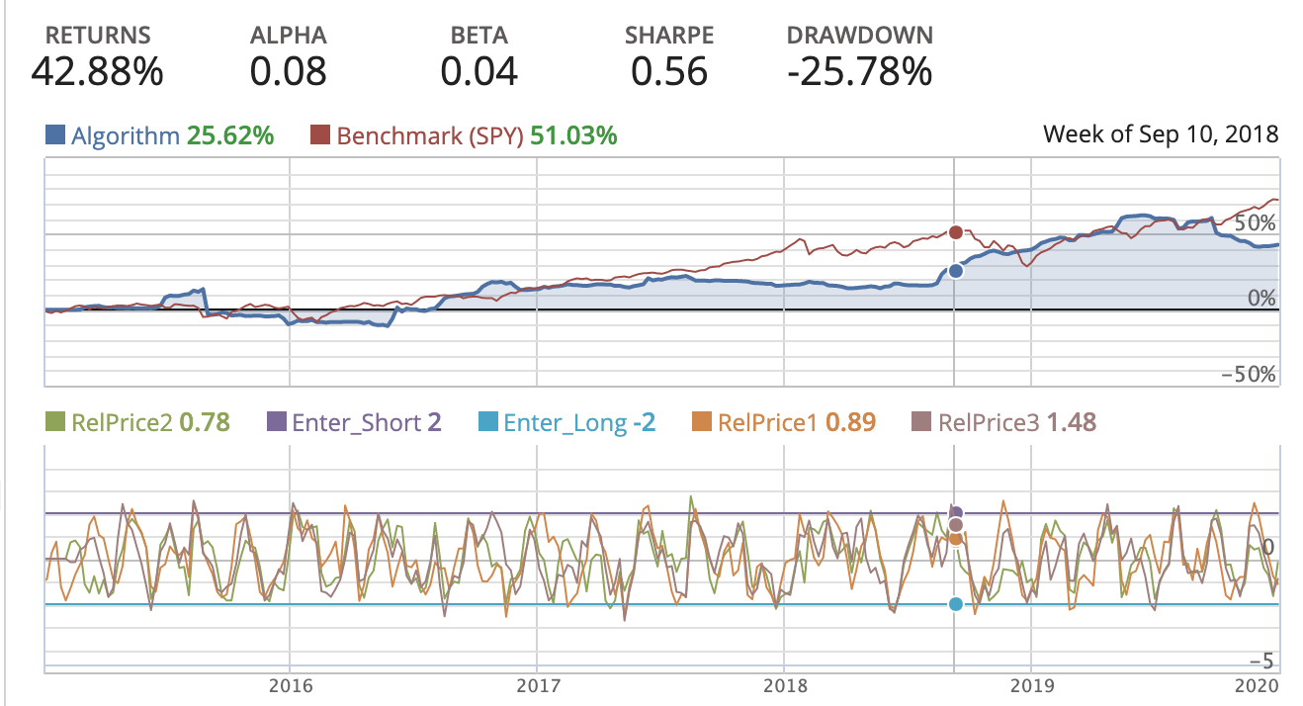
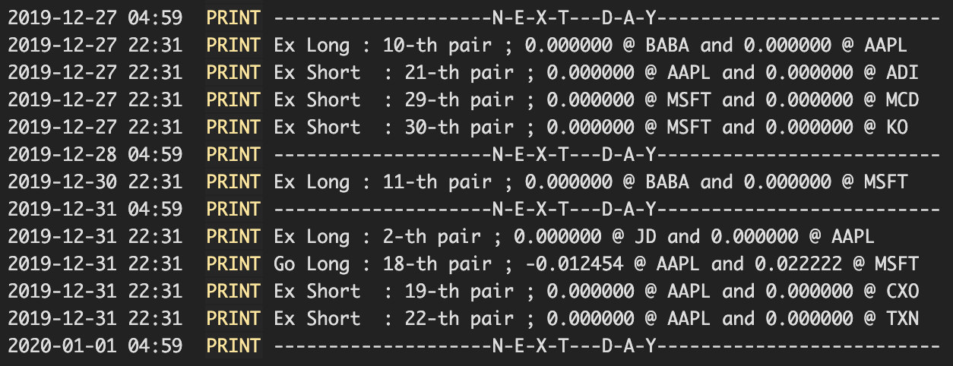
PART FIVE: Performance
Initial Investment: $0.5 million; time horizon: January 1, 2015 - January 1, 2020

Slide 45
Conclusion
Control leverage strategy performs very well, especially after 2018, since it can make take advantage of the momentum strategy as well as limit the leverage.
The returns of these turtle and momentum strategies are no more than 20%, which not good enough. In the future, we can optimize the strategies.
Differential trend motion strategy has been successfully applied to two stocks--ANF and AINV. Their annual return and sharp ratio can outperform the benchmark. Especially, ANF can gain 109% of annual return.
The reason why psy strategy does not outperform the benchmark is that for complex financial markets, simple models cannot work well, and the factor used is too subjective and worth improving.
For being a successful pairs trading strategy, it is of great importance to know when to initiate the pairs trade and when to close all positions.

Slide 46
THANK YOU FOR WATCHING

